Slide 1
TEEP Internship Program Final Report
Project:
BUILDING WEB APPLICATION ABOUT COLD STORAGE TEMPERATURE MANAGEMENT
Yuan Ze University
Advisor: PhD. Quang Thai HO
Presenters: Minh Bang LE, Cong Danh CAO. From Can Tho University

Slide 2
01
INTRODUCTION
04
RESULTS
CONTENTS.
02
LITERATURE REVIEW
05
DEMO
03
METHODOLOGY
06
CONCLUSION
Presenters: Minh Bang LE, Cong Danh CAO. From Can Tho University

Slide 3
01
INTRODUCTION
04
RESULTS
CONTENTS.
02
LITERATURE REVIEW
05
DEMO
03
METHODOLOGY
06
CONCLUSION
Presenters: Minh Bang LE, Cong Danh CAO. From Can Tho University

Slide 4
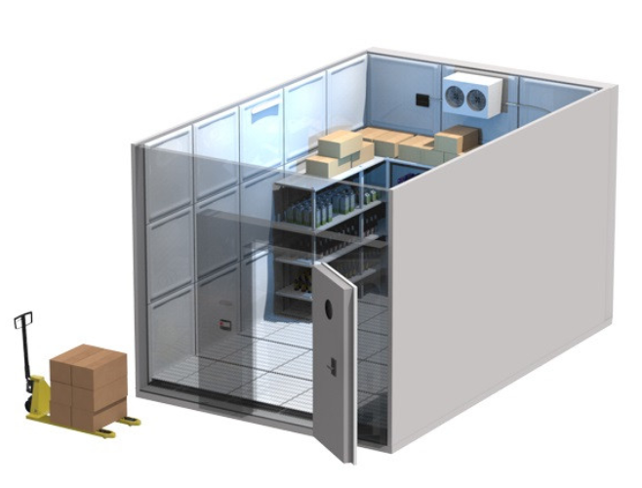
PROBLEM STATEMENT
1. Introduction
Simulating …
Sensor
15°C
Cold Storage
Monitor
24°C
How,
To measure the temperatures at locations without sensors there ?

Slide 5
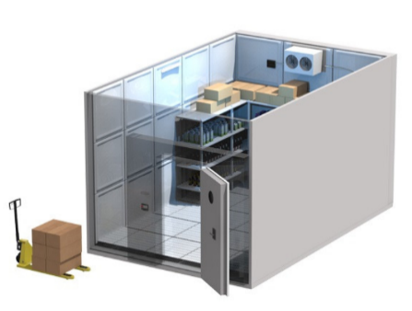
SOLUTION
1. Introduction
Setup …
Yeah,
Just install sensors at all locations
Cold Storage
Oops!
We must have a lot of money
How about,
Developing an software that can help us to calculate all location temperatures ?

Slide 6
01
INTRODUCTION
04
RESULTS
CONTENTS.
02
LITERATURE REVIEW
05
DEMO
03
METHODOLOGY
06
CONCLUSION
Presenters: Minh Bang LE, Cong Danh CAO. From Can Tho University

Slide 7
RELATED LITERATURE
2. Literature review
Related projects:
Faceworks by TIT, Cold storage monitoring by Discruptive technologies, …
Abdulrahman Alkandari, Altaf Alshammari, Samer Moein, "Temperature and Humidity Management of the Storage Houses of Food Using Data Logger“, Proceedings of 2016 6th International Workshop on Computer Science and Engineering, pp. 193-200, Tokyo, 17-19 June, 2016.
Asif Bin Karim and et al, “Monitoring food storage humidity and temperature data using IoT”, MOJ Food Processing & Technology, 10 August, 2018.
Limitations:
Focus on business processes.
Displays temperature as number or 2D line charts only.
The collected temperature value is only value at where has sensor.

Slide 8
PROPOSAL
2. Literature review
Develop a system that ueses:
Trilinear interpolation to figure out the temperature value at each unit in storage base on values that are collected from the sensors, the sensors are installed in cold storage (the number of sensors is limited).
Then, from the processed data, the value temperature will be converted into distinct color, simulate and display the temperature of the whole storage in 3D space.

Slide 9
01
INTRODUCTION
04
RESULTS
CONTENTS.
02
LITERATURE REVIEW
05
DEMO
03
METHODOLOGY
06
CONCLUSION
Presenters: Minh Bang LE, Cong Danh CAO. From Can Tho University

Slide 10
REQUIREMENTS
3. Methodology
Authorization
Creating a flexible foundation to extend more features in the future
Sensor Management + 3D Temperature Monitoring
Simulating the sensor locations, and temperature monitoring with 3D Model
Pallet Management
Simulating, and Managing how to setup Pallets with 3D Model

Slide 11
DESIGN (Authorization)
3. Methodology
Owner Account
Defining The Organization Structure
What work can employees do ?
Where will employees work for ?
Owner Account
Director / Manager / etc
Employee Account
Based on assignments
Company
Created by owner
Branch 1
Belong to the company
Branch …
Belong to the company
Storage 1.1
Belong to the branch
Storage 1.2
Belong to the branch

Slide 12
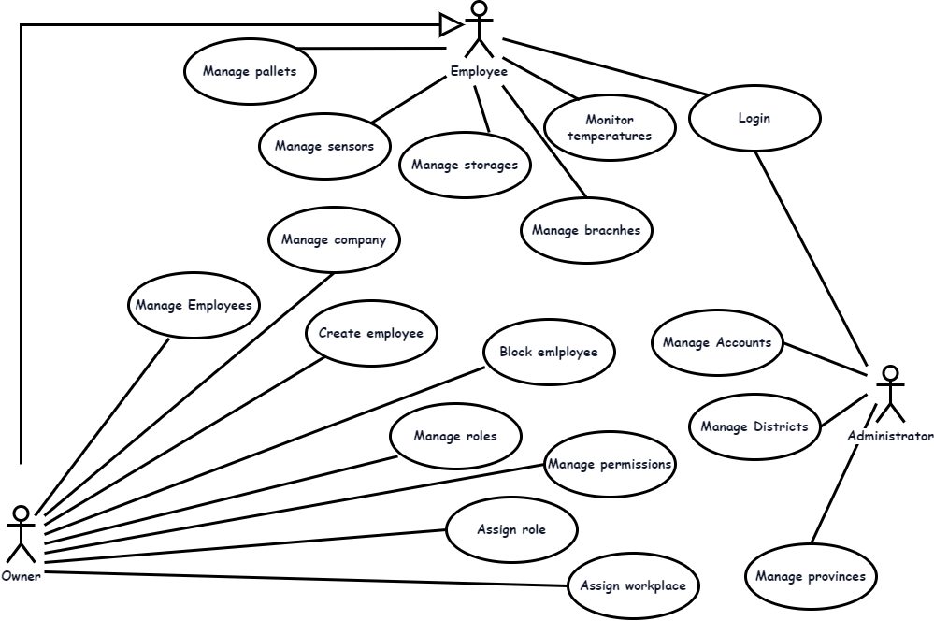
DESIGN (Use Case)
3. Methodology
Focus on
1. Monitoring Temperatures
2. Manage Pallets
3. Manage Sensors
4. Assign roles

Slide 13
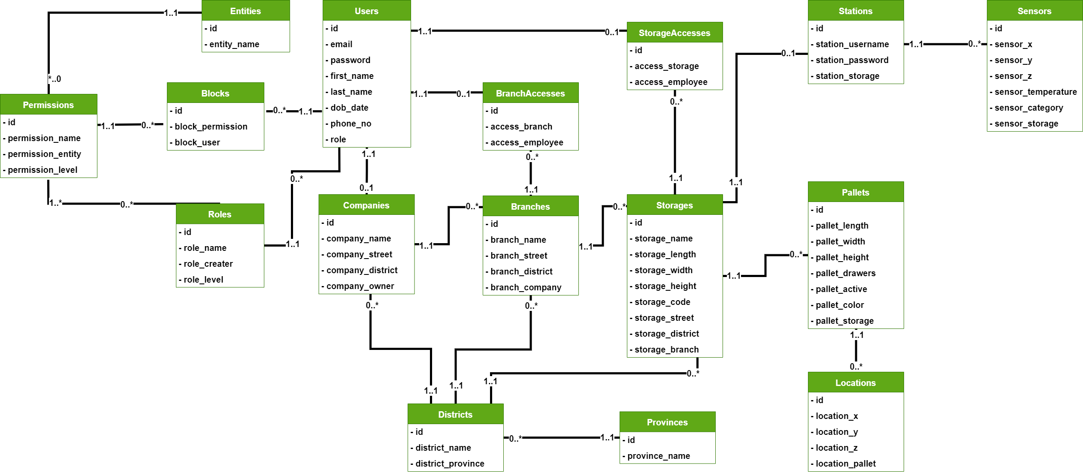
DESIGN (Class Diagram ~ Database)
3. Methodology

Slide 14
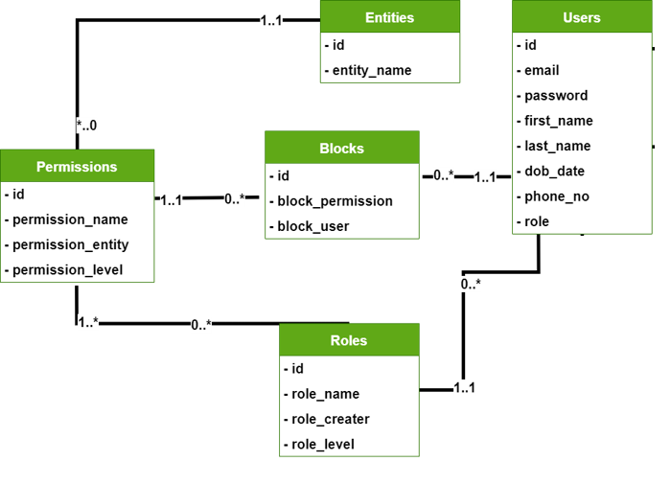
DESIGN (Users and Authorization Data)
3. Methodology

Slide 15
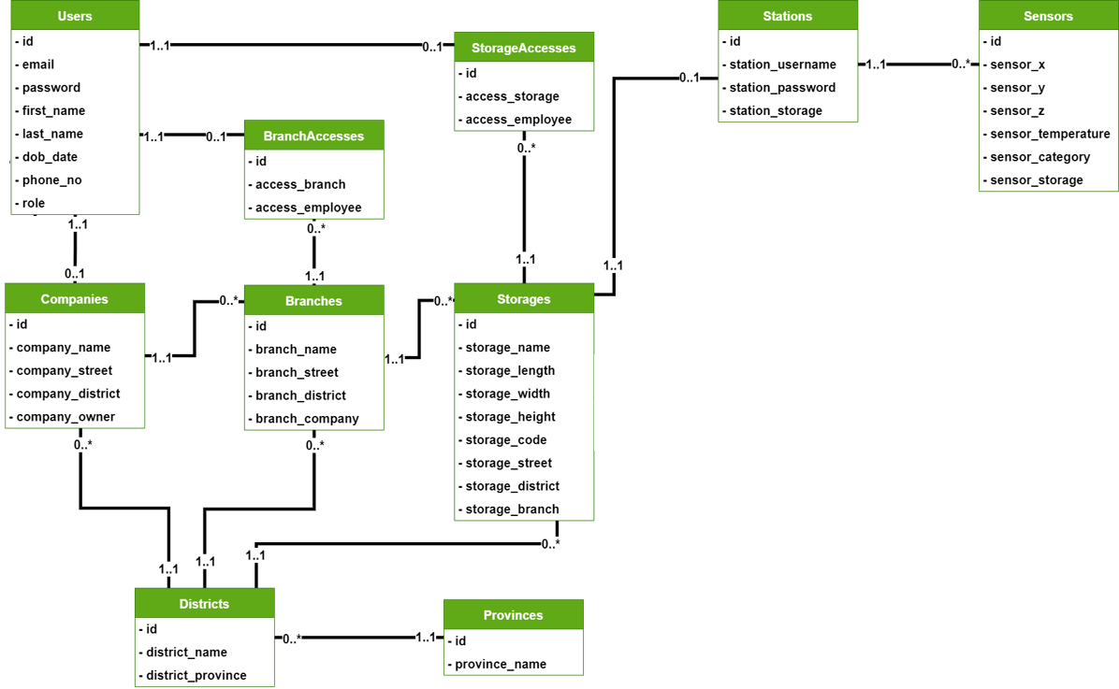
DESIGN (Organization Structure Data)
3. Methodology

Slide 16
DESIGN (Pallet Locations)
3. Methodology

Slide 17
DESIGN (Architecture)
3. Methodology
Real-time Temperatures
Using Multi - Threads Technique
to create another Thread of CPU to catch,
and process temperatues continuously.
Client
Browser, Mobile Apps
Temperatures
Real-time
Sensor Layout
Updating sensor locations in Storage
when have any changes.
Primary Server
Primary Database
Sensor Layout
Of our Storage
Temperatures
Real-time
Sensors
Sensor Server
Sensor Database

Slide 18
Simualtion, and The Problem
CONTENTS RESEARCH
3. Methodology
12.5
Simulating
14
12.7
Measuring
Cold Storage
3D Model
How,
To measure the temperatures at locations without sensors there ?

Slide 19
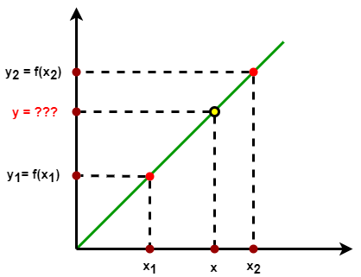
From LINEAR to TRILINEAR Interpolation
CONTENTS RESEARCH
3. Methodology
8 verties / sensors
is required in
t(x,y,z)
Trilinear
Interpolation
t(x,y,z)
Linear Interpolation
Yeah,
we can calculate every temperature points
t(x,y,z)

Slide 20
Improving, and New Problem
CONTENTS RESEARCH
3. Methodology
But,
Can we add more than 8 verties / sensors ? TRY 9 !
Case 1
Case 2
Case 3
8 required
Sensors / verties
An added sensor
Sensor 9th
Virtual sensors
Calculating by trilinear interpolation with 8 verties / sensors

Slide 21
New Problem … Again!
CONTENTS RESEARCH
3. Methodology
Space Dividing
Yeah! We can perform trilinear interpolation of each part first, then collect all as the final step …
But,
can we add more than 9 sensors ?

Slide 22
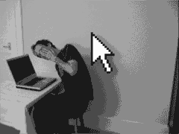
Keep moving on!
CONTENTS RESEARCH
3. Methodology
It look like
Recursion Technique
Again, and again !
Yeah,
Just divide it until have not any sensors in child parts

Slide 23
CONTENTS RESEARCH
3. Methodology
Cold Storage
8 verties sensors
Added sensors
Step 1: To define our
Storage structure
Space Dividing
+
Recursion Technique
Divided structure of our storage
We just save it !

Slide 24
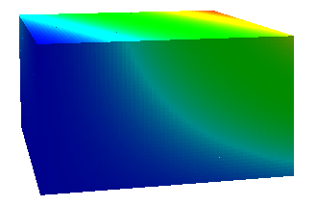
CONTENTS RESEARCH
3. Methodology
Calculating
All temperature
values in each parts
Getting
The structure
We saved !
Step 2: To calculate
temperature values
Collecting
All of parts, and build our colorful Storage 3D
Trilinear Interpolation

Slide 25
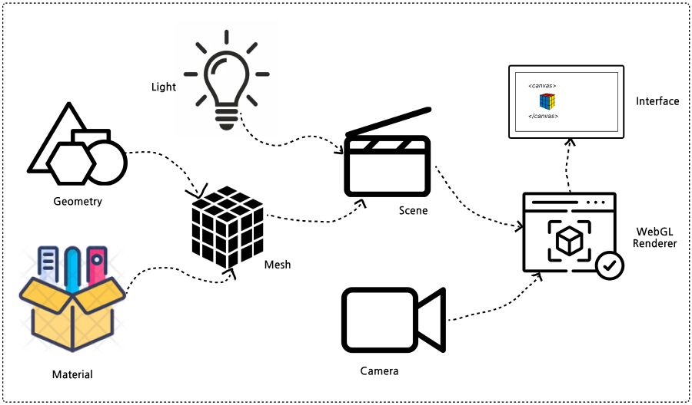
TECHNIQUE FOR BUILDING 3D OBJECT AND SPACE
3. Methodology
build 3D object
build 3D space

Slide 26
SIMULATE AND DISPLAY TEMPERATURE
3. Methodology
🌡1ºC
{x: 4, y:4, z: 1}
🌡3ºC
{x: 0, y:0, z: 0}
🌡-5ºC
{x: 0, y:0, z: 0}

Slide 27
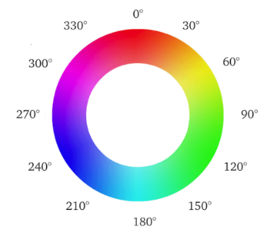
SIMULATE AND DISPLAY TEMPERATURE
3. Methodology
For temp value:
Start
hsl(hue, saturation, lightness)
maxTemp = -8
minTemp = -11
currentTemp = -9
hsl(hue, 100%, 50%)
Create 3D space
?
$$Hue=240− \frac{\left(maxTemp − currentTemp\right)∗210}{maxTemp − minTemp}$$
Hue = 170
hsl(170, 100%, 50%)
Convert temperature value array
to color array
HSL color wheel
For coordinate:
Loop throught the converted array to create collection of cubes and put it in the corresponding position
End

Slide 28
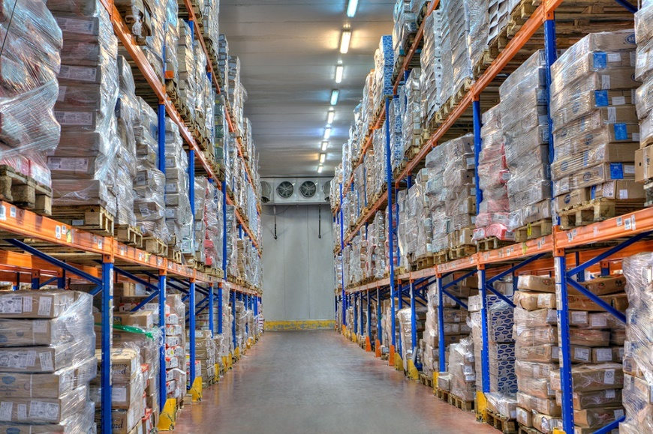
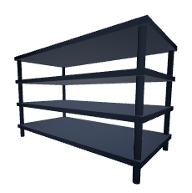
SIMULATE COLD STORAGE SHELVING (PALLET)
Start
The pallet is defined as:
shelves
Enter shelf size
Create 3D space
Cylinder
Rectangular
Create rectangular and cylinder
Put it in its position
Caculate position (coordinates) for each object
Put it in the corresponding position
+
=
End

Slide 29
01
INTRODUCTION
04
RESULTS
CONTENTS.
02
LITERATURE REVIEW
05
DEMO
03
METHODOLOGY
06
CONCLUSION
Presenters: Minh Bang LE, Cong Danh CAO. From Can Tho University

Slide 30
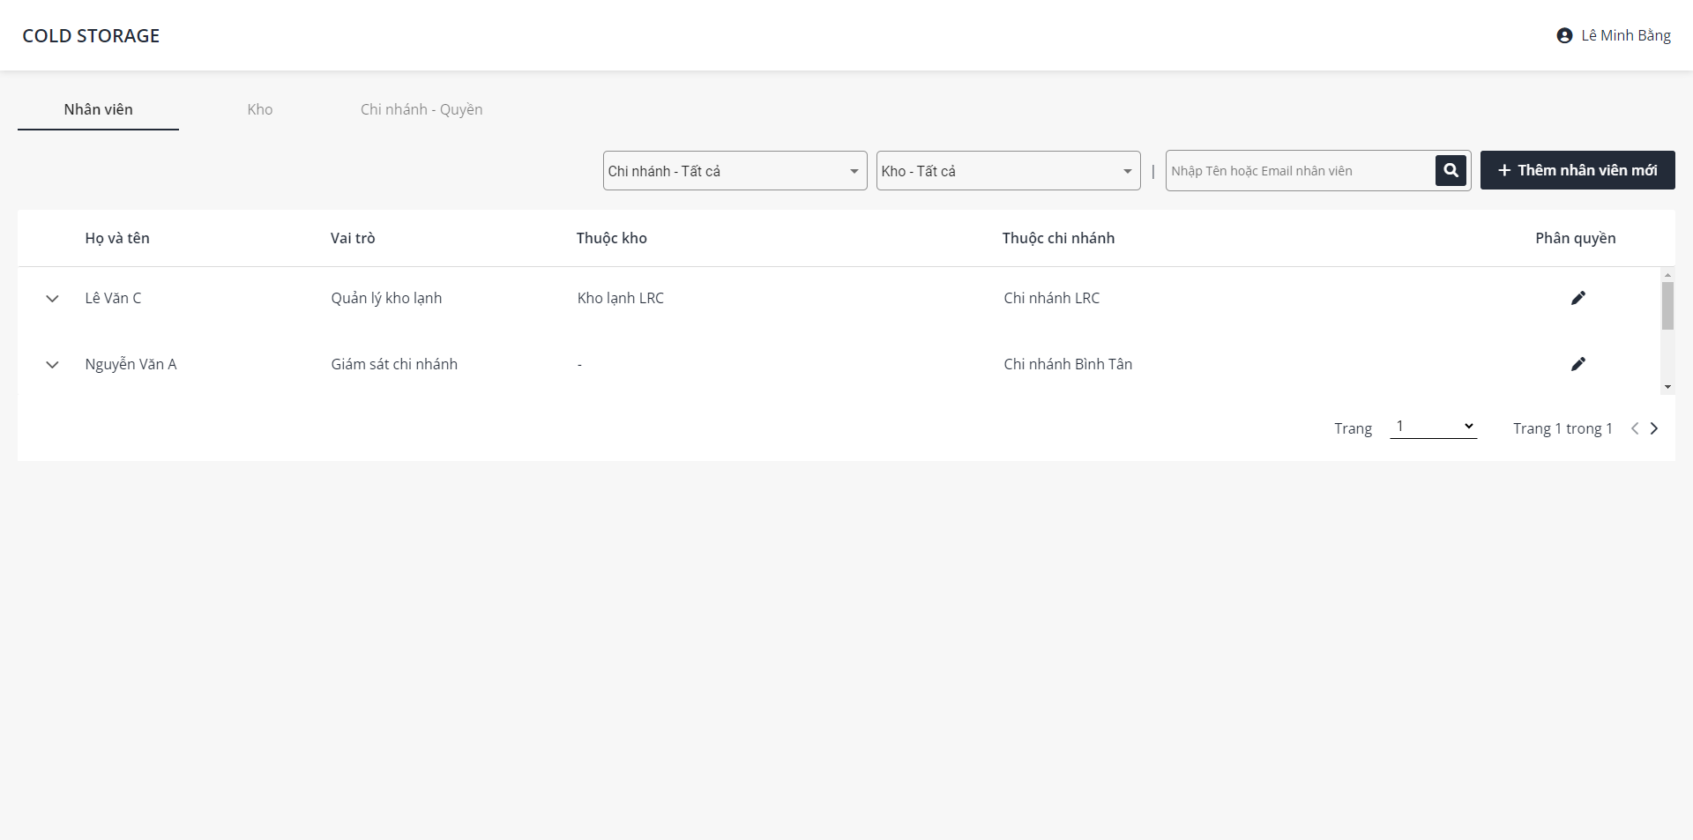
RESULTS
4. Results
Branch, authority management
Employee management
Storage management
Admin features

Slide 31
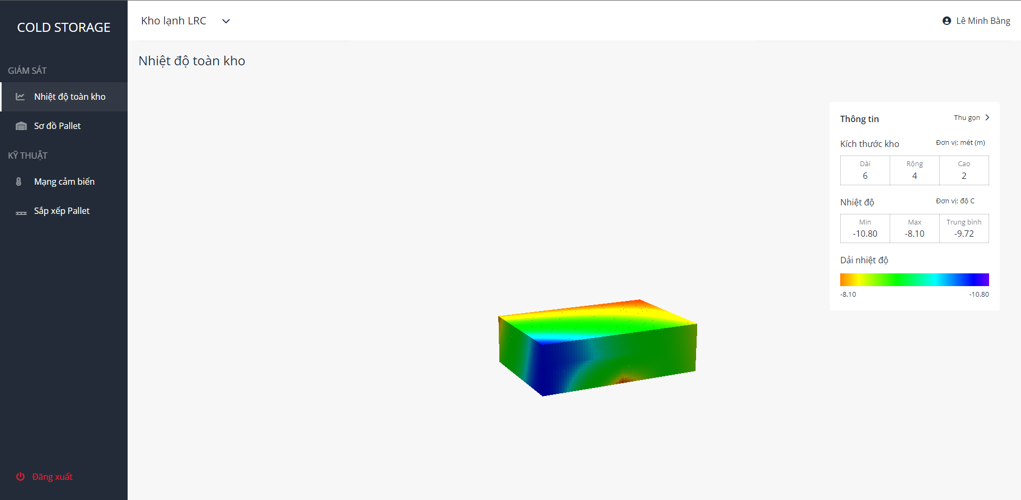
RESULTS
4. Results
Monitor temperature

Slide 32
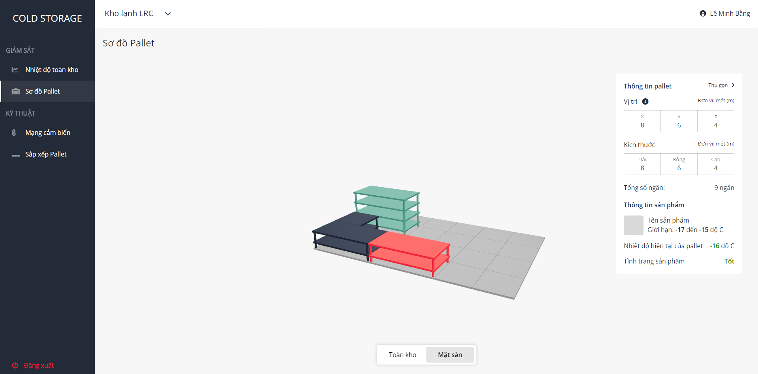
RESULTS
4. Results
Monitor shelves

Slide 33
01
INTRODUCTION
04
RESULTS
CONTENTS.
02
LITERATURE REVIEW
05
DEMO
03
METHODOLOGY
06
CONCLUSION
Presenters: Minh Bang LE, Cong Danh CAO. From Can Tho University

Slide 34
01
INTRODUCTION
04
RESULTS
CONTENTS.
02
LITERATURE REVIEW
05
DEMO
03
METHODOLOGY
06
CONCLUSION
Presenters: Minh Bang LE, Cong Danh CAO. From Can Tho University

Slide 35
CONCLUSION
5. Conclusion
Results:
Employee, storage, branch management.
Applied trilinear interpolation method to interpolate temperature basically.
Simulated temperature, objects, storage in 3D space.
Limitations:
There is no notification when the temperature change.
Size and shape of storage is still limited.
Future research:
Simulate others environmental factors.
Improve trilinear interpolation formula to match many different storages.
Expand the capacity of other 3D object simulation in storage.

Slide 36
THANK YOU FOR FOLLOWING!

